Slide 1
Miso: Structured Note Extraction
Capstone Project of Ann Sasi & Fariha Lateef (AIEA Lab) with Alec Raymond
Advised by Prof. Leilani Gilpin

Slide 2

Motivation
How can we streamline access to all learning materials?
Goal
Create a that reconstructs clean, structured, and system readable documents while preserving original layout and content.
Varied Note Formats
Handwritten notes
Pseudocode snippets
Diagrams and figures
Screenshots and annotations
Challenges
Difficult to organize large file collections
OCR struggles with unstructured notes
Formatting and diagrams often lost
Manual rewriting is time consuming

Slide 3


Related Works
Donut: OCR-Free Document Understanding Transformer (2022)Naver
Image → Transformer → Structured Output
OCR-free document understanding model
Uses image directly instead of relying only on OCR
Preserves document structure and layout
Nougat: Neural Optical Understanding for Academic Documents (2023)Naver
Why not pure OCR?
Neural document parsing for academic PDFs
Converts scanned documents into structured markup
Focuses on formatting preservation

Slide 4

Methodology: CRON job to combine OCR & LLM capabilities
OCR: Optical Character Recognition
Goal: Use an OCR to convert images of handwriting into a “textual guess”
APIs:
Azure Vision
Adobe OCR
Tesseract
LLM: Large Language Model
Goal: Feed LLM OCR extracted text along with handwriting images to produce more accurate results
APIs:
Claude API
OpenRouter API

Slide 5


Base Pipeline
folder_open
auto_fix_high
document_scanner
1. Data Ingestion
Load handwritten or scanned notes from a targeted image folder.
2. Preprocessing
Grayscale conversion
Noise reduction
Contrast & Sharpening
Deskewing
3. OCR Processing
Extracts text regions into structured JSON including:
detected text
confidence scores
output
picture_as_pdf
4. LLM Integration
Interpret OCR output and image, inject detected diagrams/images into JSON text
5. Final Output Generation
Generate reconstructed PDF, markdown, or Google Doc

Slide 6

Cron Job
Cron job: Outer shell connecting each logic layer, running at automated intervals
Full automation: the system runs itself every day at a scheduled time (9 AM) → user does not need to intervene
No technical knowledge required after setup: Once configured, the user simply drops images into a folder → system handles everything else automatically
Scalability: The cron job processes any number of images in a single run → easily scalable to different sets of notes

Slide 7
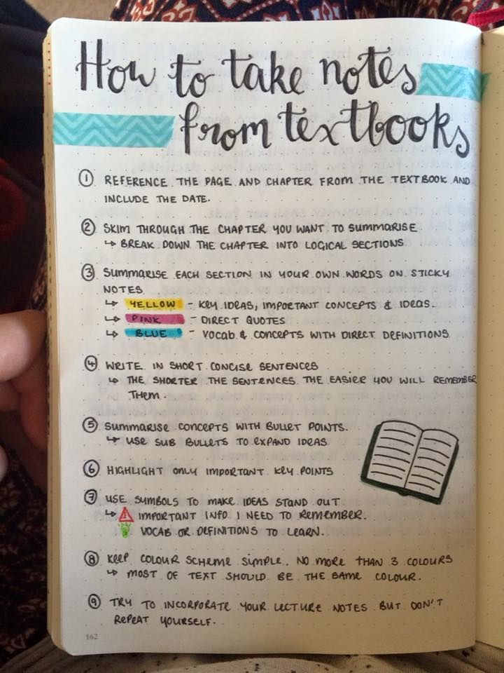
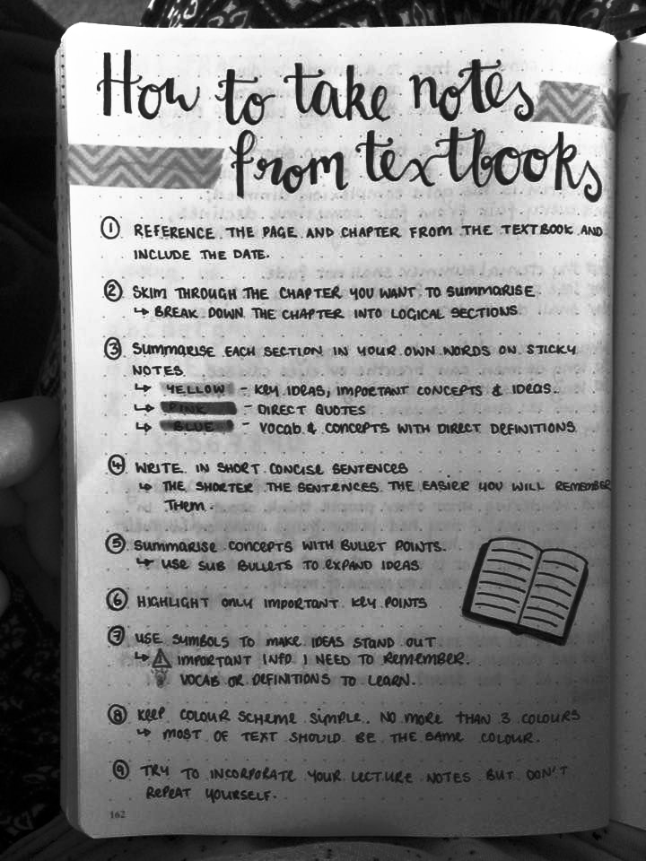
Preprocessing
Techniques:
Convert image to grayscale
Remove background noise
Apply thresholding/binarization
Enhance contrast and sharpness
Correct skewed or rotated images
Normalize image resolution
Benefits:
improves text visibility
reduces OCR detection errors
increases extraction accuracy
produces cleaner structured output for the LLM

Slide 8
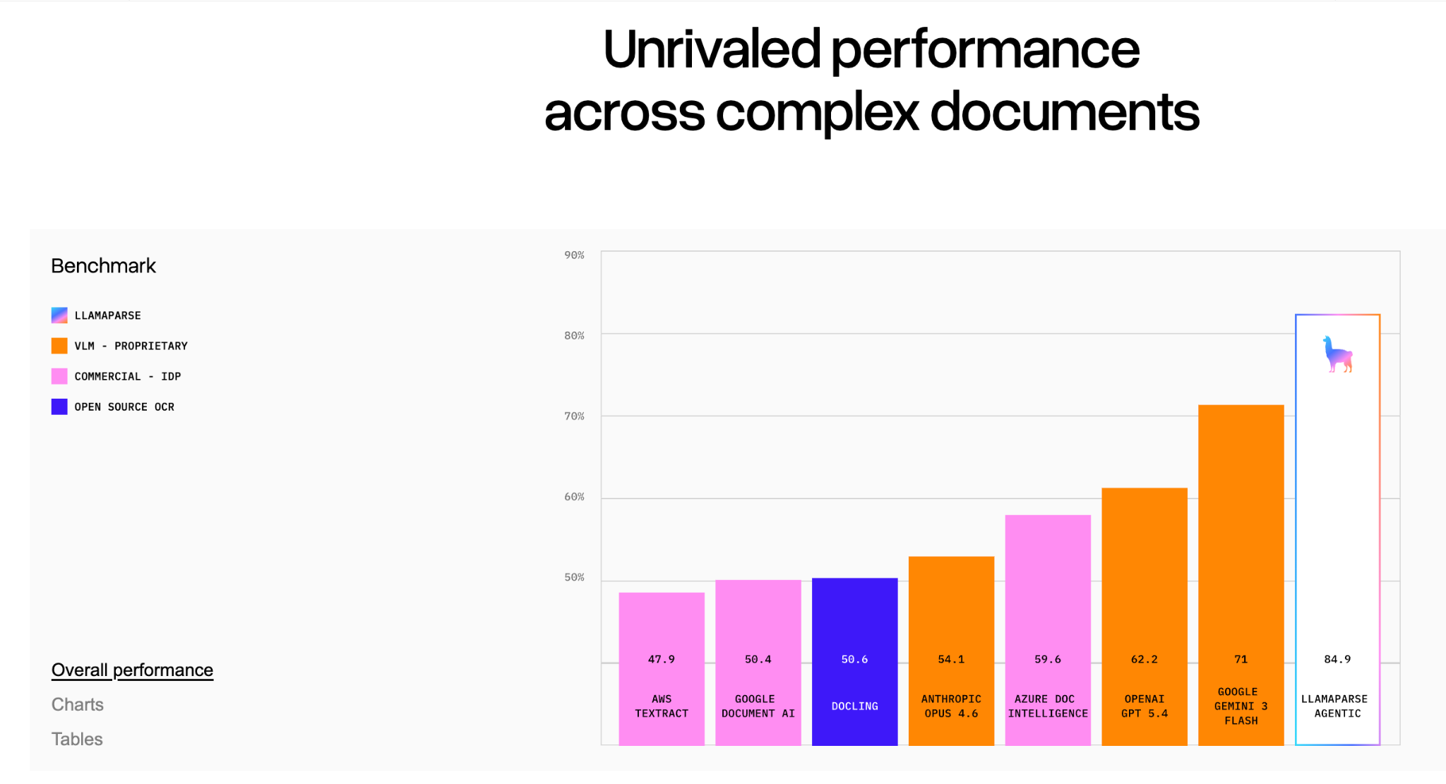
Tesseract:
What was promised:

Slide 9
Real Performance
Tesseract Output
(0) REFERENCE THE PAGE AND CHAPTER FROM THE TEXTBOOK AND |
INCLUDE TE DATE.
© stim THROUGH THE CHAPTER YOU WANT: TO SUMMORISE
“> SAE Dab ee feaihecees teat Ea ca
@. summarise ACH SECTION. IN YOUR OWN NORDS OM. STICKY.
NOTES.
+ Sea = KOA 100A; impoe TAT CONCEPTS: & 10e0S..
> GE - rect QuoTes 4
‘> SNR Yorn. COMGAPTE ron mE DerwarTiONS .
@ were. wm woer cowese sevrences =
  le THE, SHoeTER THE Sevreniees. THE EARICR HOU WiLL

Slide 10


Adobe API
Converts PDFs into machine-readable text
Implemented and evaluated across ~20 documents
Performs well on structured digital PDFs
Struggles with handwritten notes and noisy inputs
Observation:
Handwritten content produced inconsistent extraction results and loss of formatting.
Key Limitation:
Adobe API documentation notes limited support for handwritten documents.
Notes:
ann

Slide 11
Azure Vision
Microsoft’s Vision model within the Azure suite

Slide 12
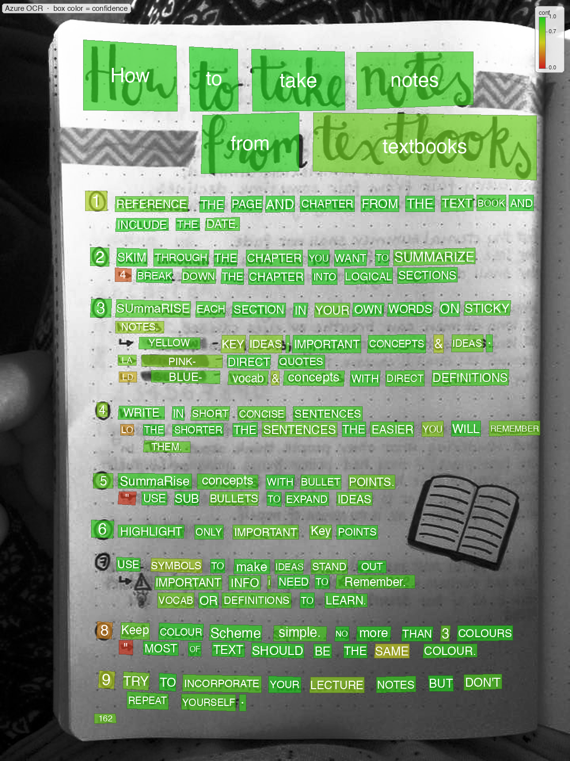
Azure OCR
Word by word detection
Each word has a confidence value from 0 - 1.0
Tuned for handwriting
Proprietary Internals (Black Box)
  500 free pages per month

Slide 13
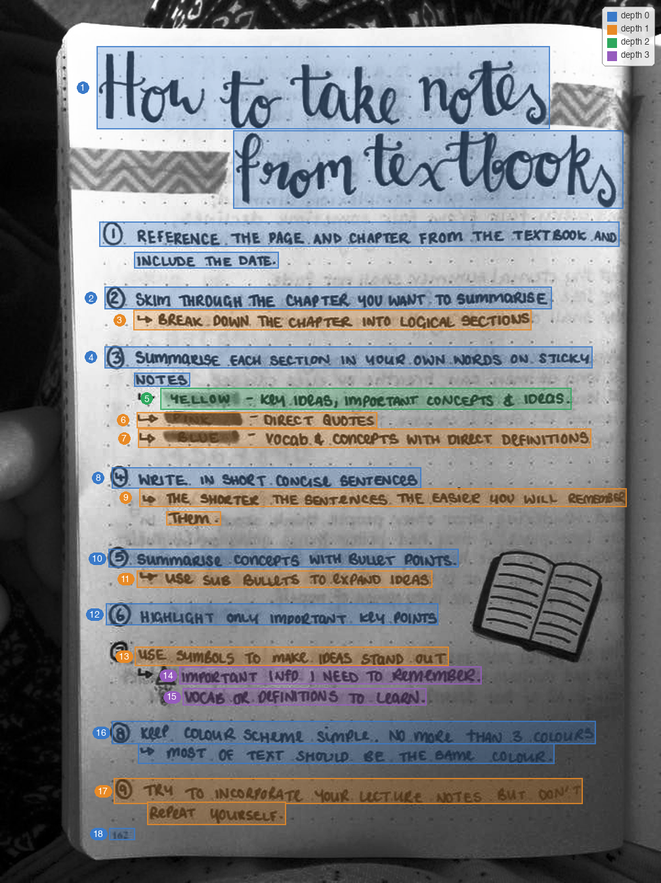
Layout Text
Groups the words into line strings
  Detects line breaks
Merges soft wrapped continuations
Detects indentations
Prepares the OCR output for VLM

Slide 14
How can we address OCR + LLM confusion?
How can we address OCR + LLM confusion?
How can we address OCR confusion?
Traditional OCRs work well for clean digital PDFs, but special characters and diagrams remain a major challenge. This motivated our shift toward using OCR combined with multimodal LLM reasoning
Notes:
Insert image of poor ocr json

Slide 15



Visual Language Models (VLMs)
trending_up
From OCRs to VLMs
End-to-End Processing: Rather than complex OCR pipelines, VLMs map pixels directly to structured text
Semantic Understanding: VLMs can infer messy handwriting from context, where traditional OCR sees only noise.
Layout Awareness: Naturally preserves hierarchies, tables, and spatial relationships.

Slide 16
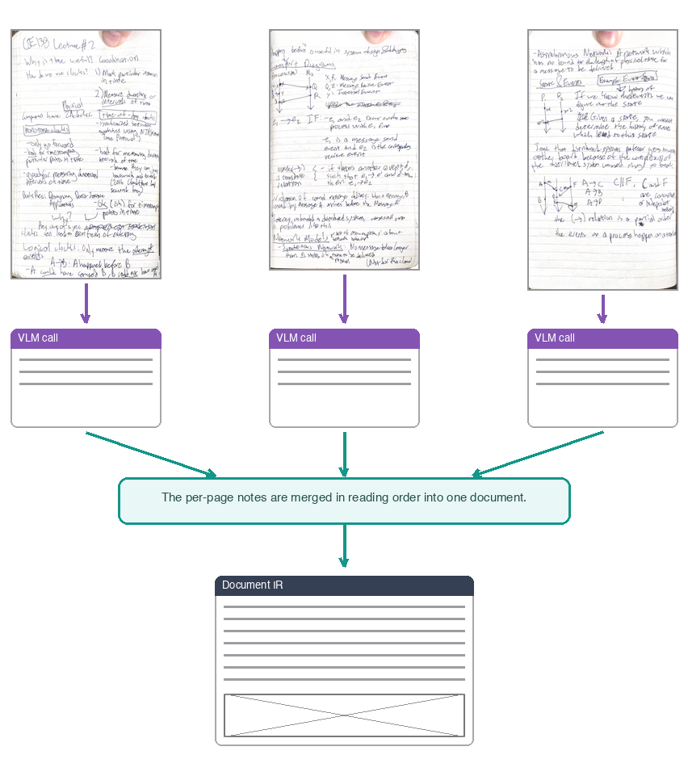
VLM Layer
Input: Note Image, Layout Text, Cache Information
Output: JSON Schema (Document IR)
Supports multi-page pdfs by splitting into multiple VLM calls
Note context from prior pages is passed forward
Pages all combined into one JSON representation

Slide 17

Diagram Detection
Prompt the LLM to
Interprets diagrams and layouts
Diagrams converted to Mermaid
Text + diagrams merged into a unified document
Output: Markdown file with text + generated diagrams
OCR to detect text + VLM to detect diagrams

Slide 18
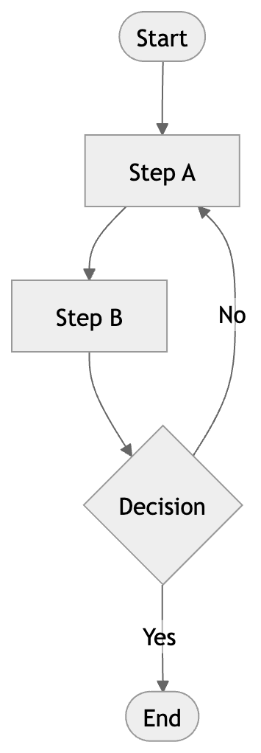

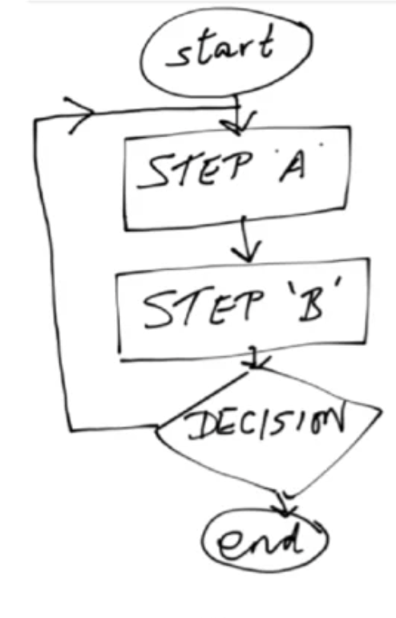
Diagrams
Prompt VLM to use Mermaid API to turn handwritten diagrams to digital depictions

Slide 19
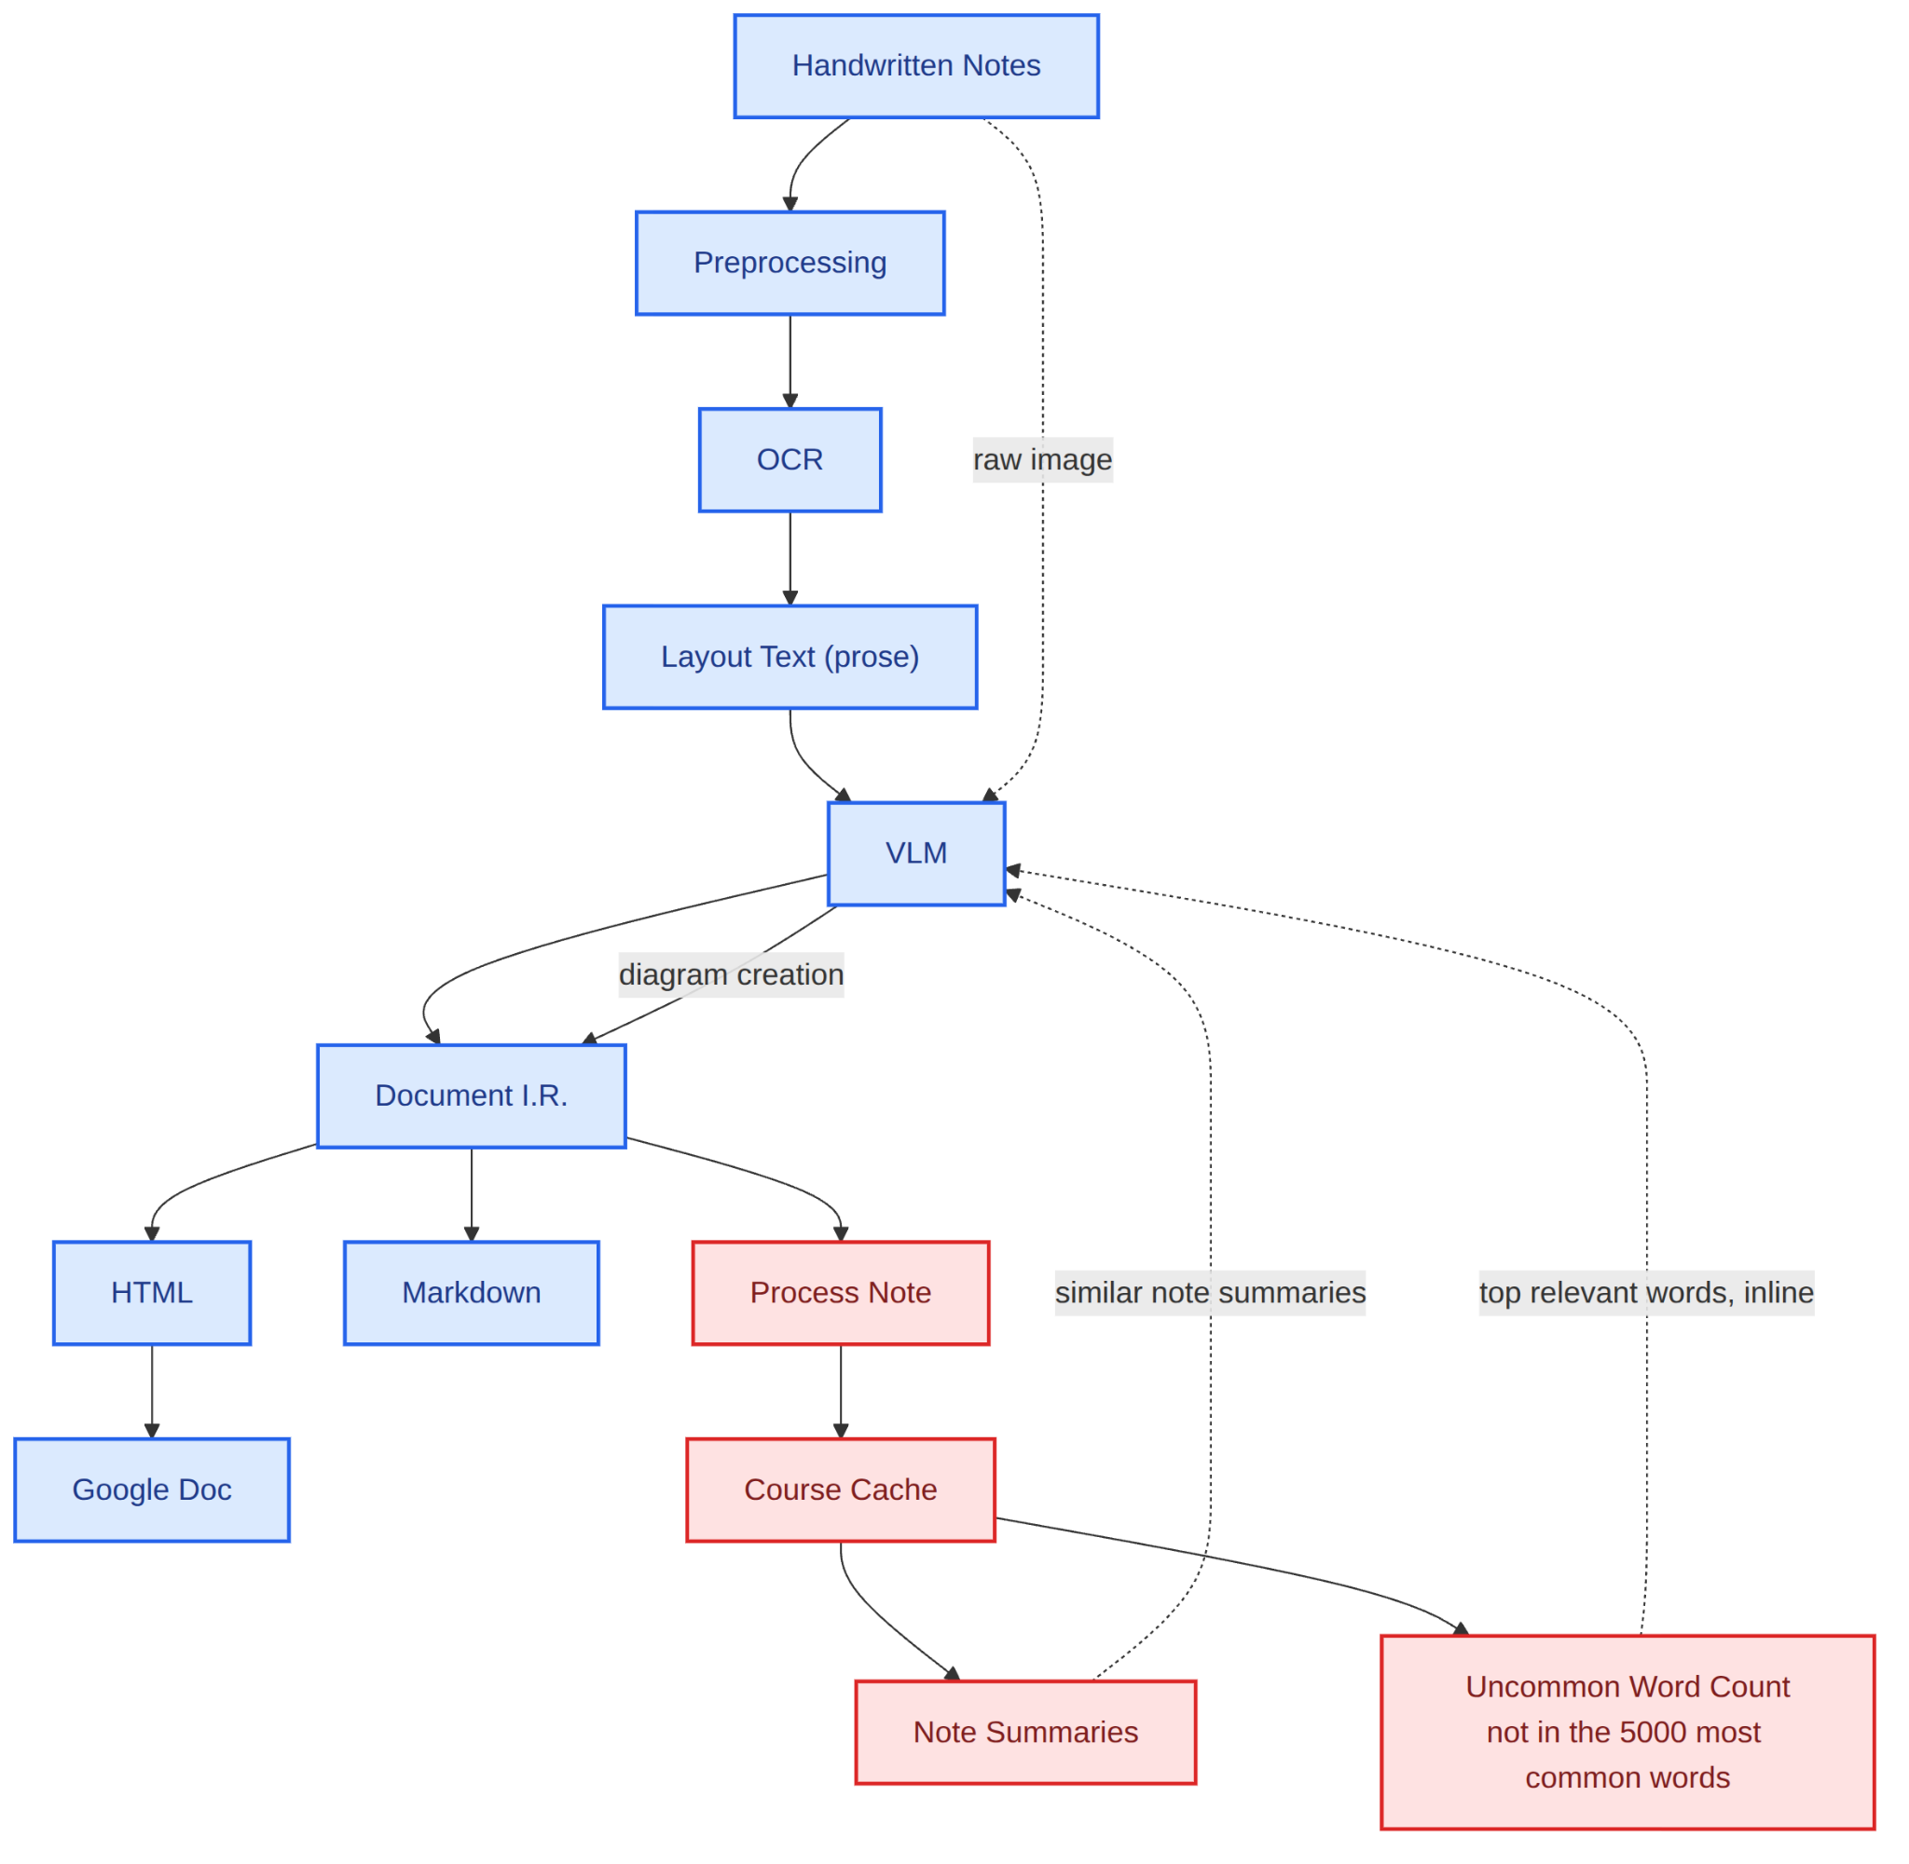
The Full Pipeline

Slide 20
Finalized Workflow
Input & Extraction:
Handwritten note images are fed into Azure OCR to extract raw text from the page
The extracted text is restructured into readable prose through a Layout Text step
VLM Processing:
Layout text and the preprocessed image are passed into a VLM
VLM detects and translates diagrams, inserting them into the output
Document Output Track:
The processed content is converted into an intermediate representation (Document I.R.) and exported as HTML, Markdown, or a Google Doc
Knowledge Enrichment Track:
Notes are processed and stored in a Course Cache for future reference
The system generates Note Summaries and pulls in similar note summaries for added context
Uncommon words (words not included the 5,000 most common English words) are flagged and surfaced inline to support vocabulary building

Slide 21
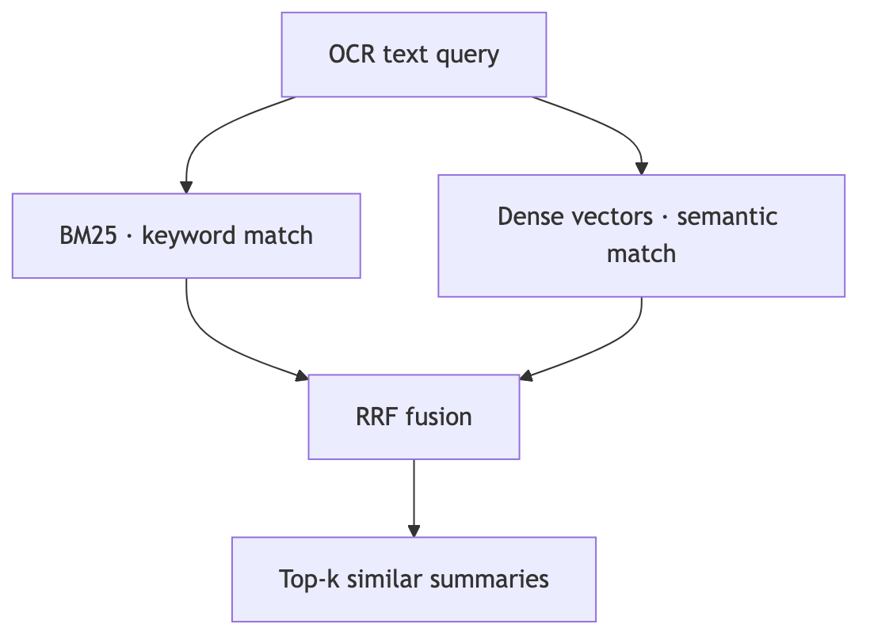
Two-Layer Course Cache
When each note is processed, a per-course cache stores two values:
  Summary + Vector Embedding
  Uncommon Word Dictionary
Based on the OCR Layout Text output, similar summaries are appended to the VLM prompt.

Slide 22
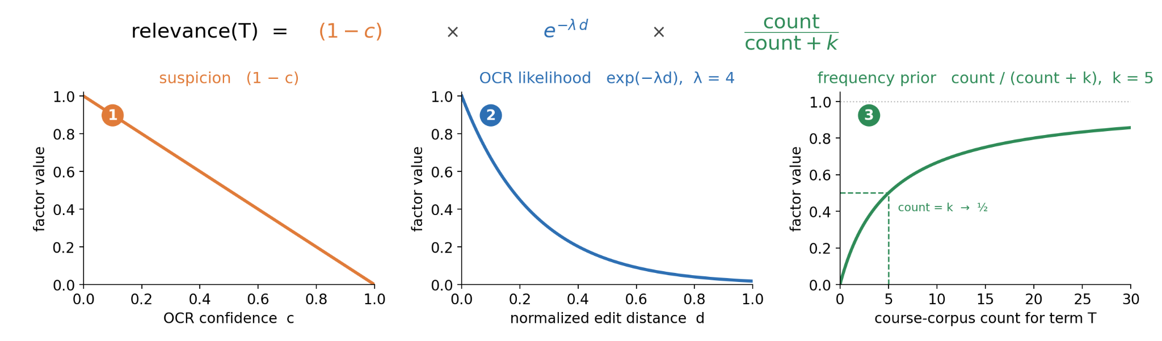
Uncommon Word Cache
Each course maintains a dictionary,
  Count of all words not in the 5000 most common English words
Each word is scored by relevance
Top 3 most relevant words (if relevance(T) > 0.05) are inserted inline into the LLM prompt

Slide 23


Evaluation & Metrics

Slide 24
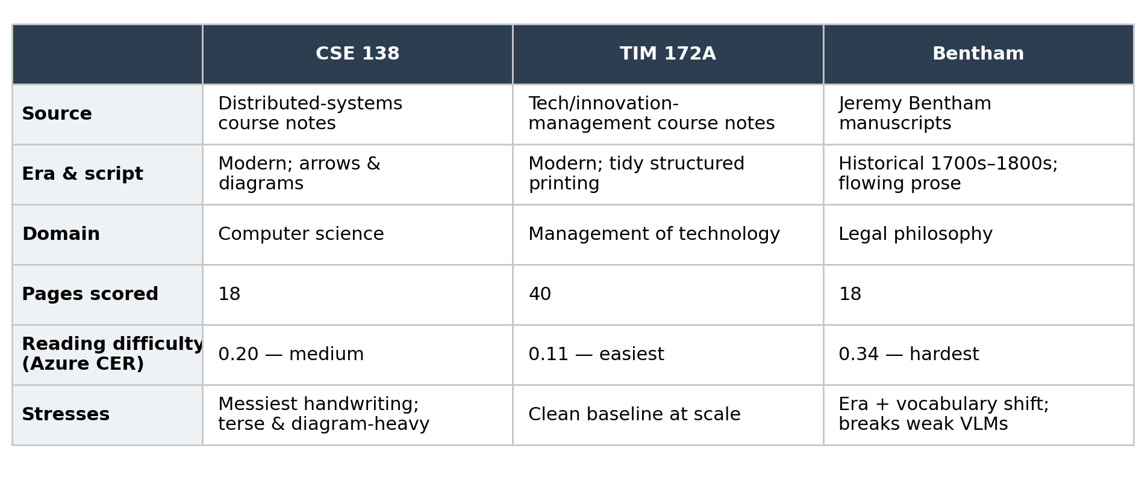
Datasets

Slide 25
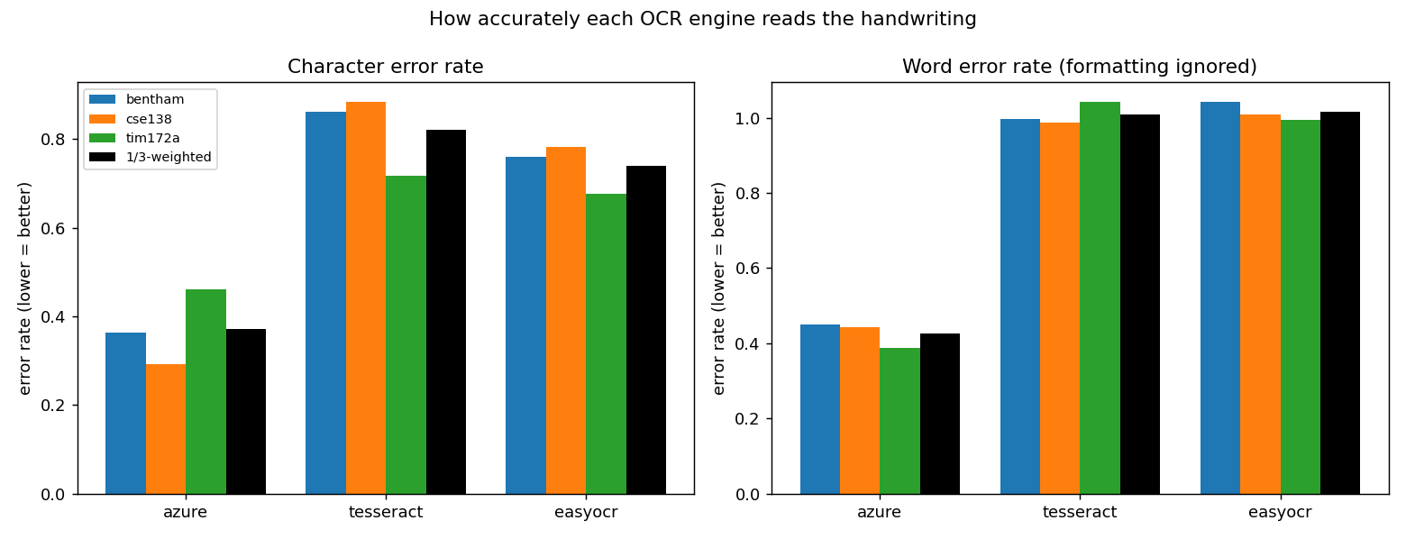
Evaluation
Azure is significantly more accurate than Tesseract for handwritten text.
Azure's CER is between 0.29-0.46, while Tesseract's CER sits around 0.71-0.88, which is significantly worse
Tesseract’s WER is close to 1.0, compared to Azure’s WER of 0.41 - 0.46.
EasyOCR ranks similarly to Tesseract here for both WER and CER
Metrics:
CER (Character Error Rate): how many individual characters were wrong
WER (Word Error Rate): how many words were wrong

Slide 26
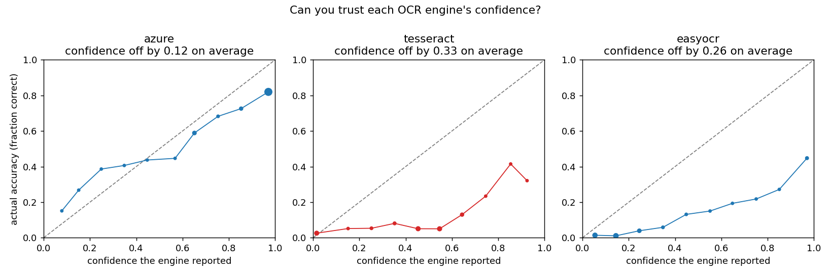
Evaluation (pt. 2)
Both EasyOCR and Tesseract are overconfident, with confidence being off by 26 - 33%; big gap in confidence and correctness!
Azure’s confidence score can be trusted; other OCRs are far behind
Azure is the most correct at higher confidence levels
Being off by only 12% is significant compared to other models

Slide 27
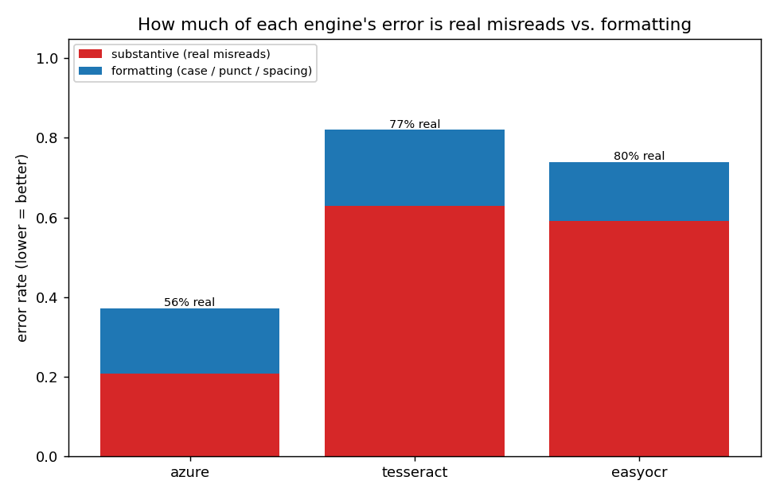
Evaluation (pt 3)
Azure:
Total CER of 37%
56% of its errors are real misreads, 45% of those are just formatting issues
Azure's formatting errors (case, punctuation, spacing) can easily be corrected by an LLM/VLM in the cleaning stage
Tesseract:
Total CER of 82%
77% of its errors are real misreads; only a small portion of those are formatting errors
Tesseract's errors are so predominantly substantive that even a powerful VLM would struggle to recover from them reliably
Red: real misreads, where the engine got the actual word wrong
Blue: surface-level errors like wrong capitalization, punctuation, or spacing

Slide 28
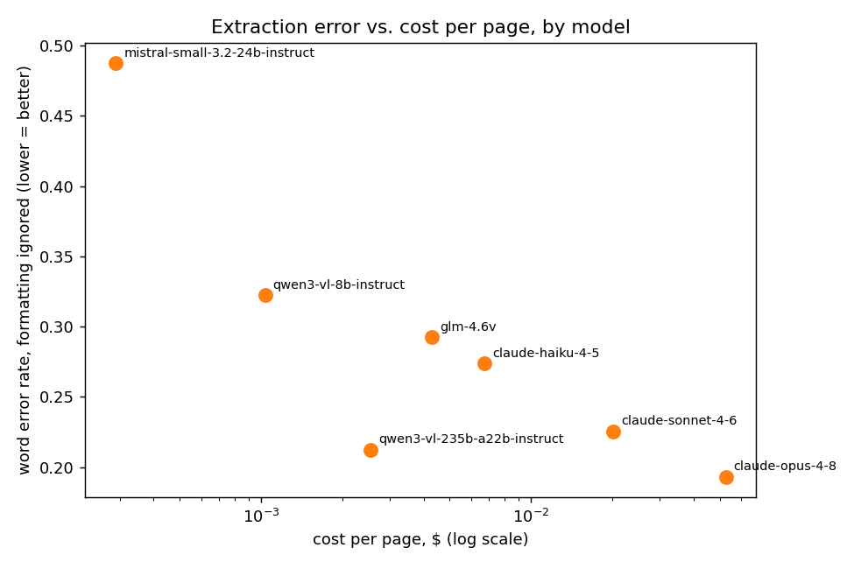
Evaluation (pt. 3)
Model | Cost/note | WER
qwen3-vl-235b | ~$0.002 | 0.20
claude-sonnet-4-6 | ~$0.02 | 0.21
claude-opus-4-8 | ~$0.045 | 0.22
Comparison of multiple models on cost vs. quality for note extraction
X axis: cost per note in dollars (log scale!)
Y axis: WER, ignoring spacing, punctuation, and other formatting differences
Winner: Qwen3
These models all achieve about the same accuracy, but Qwen3 is 20x cheaper than Opus and 10x cheaper than Sonnet.
As AzureOCR gives you 500 free pages a month, this entire system could be ran for less than a dollar per course. ($1.50 per 1k pages after)

Slide 29
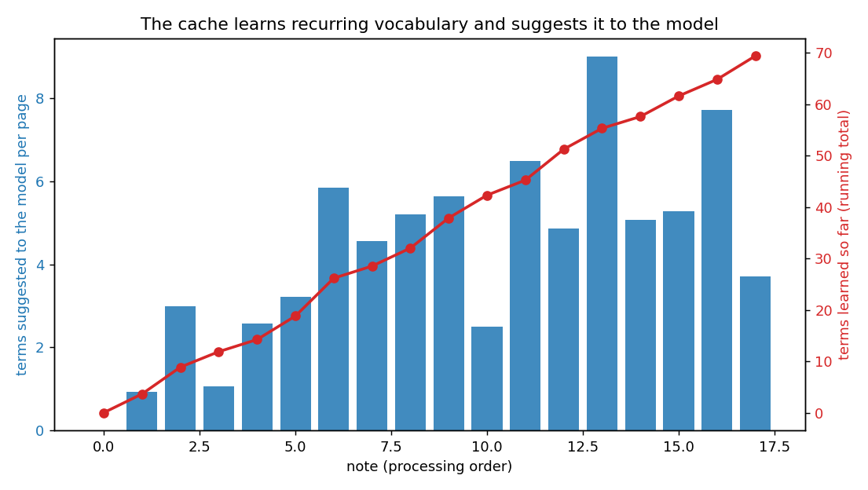
Evaluation (pt. 4)
System gets more accurate over time
  actively learning as it processes more notes
  every note is adding to the overall system vocabulary
  with 78 terms added at note 17
  Later notes benefit from earlier ones
Red line: the total vocabulary the system has built up over time
Blue bars: Number of course-specific terms flagged and sent to VLM per note by the uncommon word cache

Slide 30
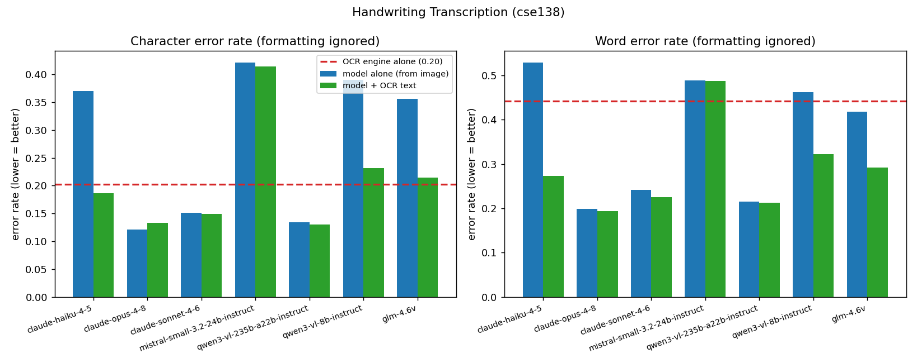
Evaluation (pt. 5)
The OCR text improved VLM outputs, especially for the weaker models.

Slide 31
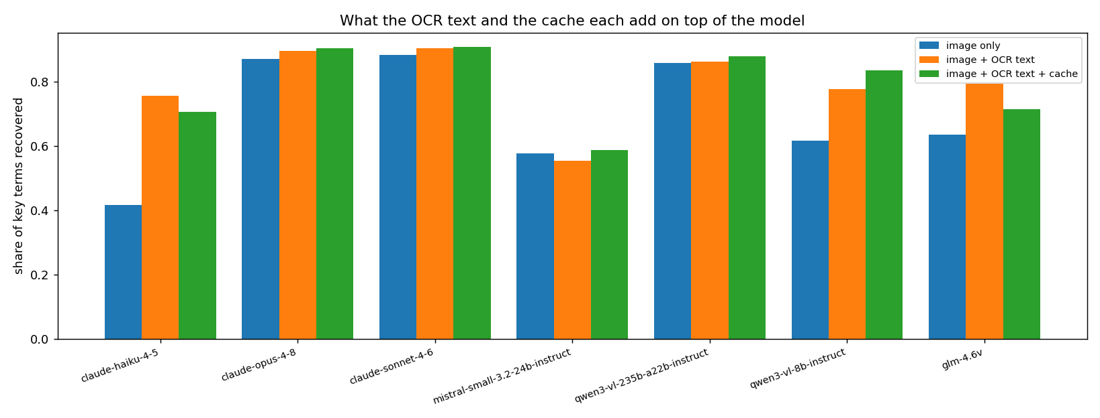
Evaluation (pt. 6)
Key Terms: LLM flagged, human validated key course terms in a note
Across the board, the OCR & Cache improve key term recall, especially for weaker models

Slide 32
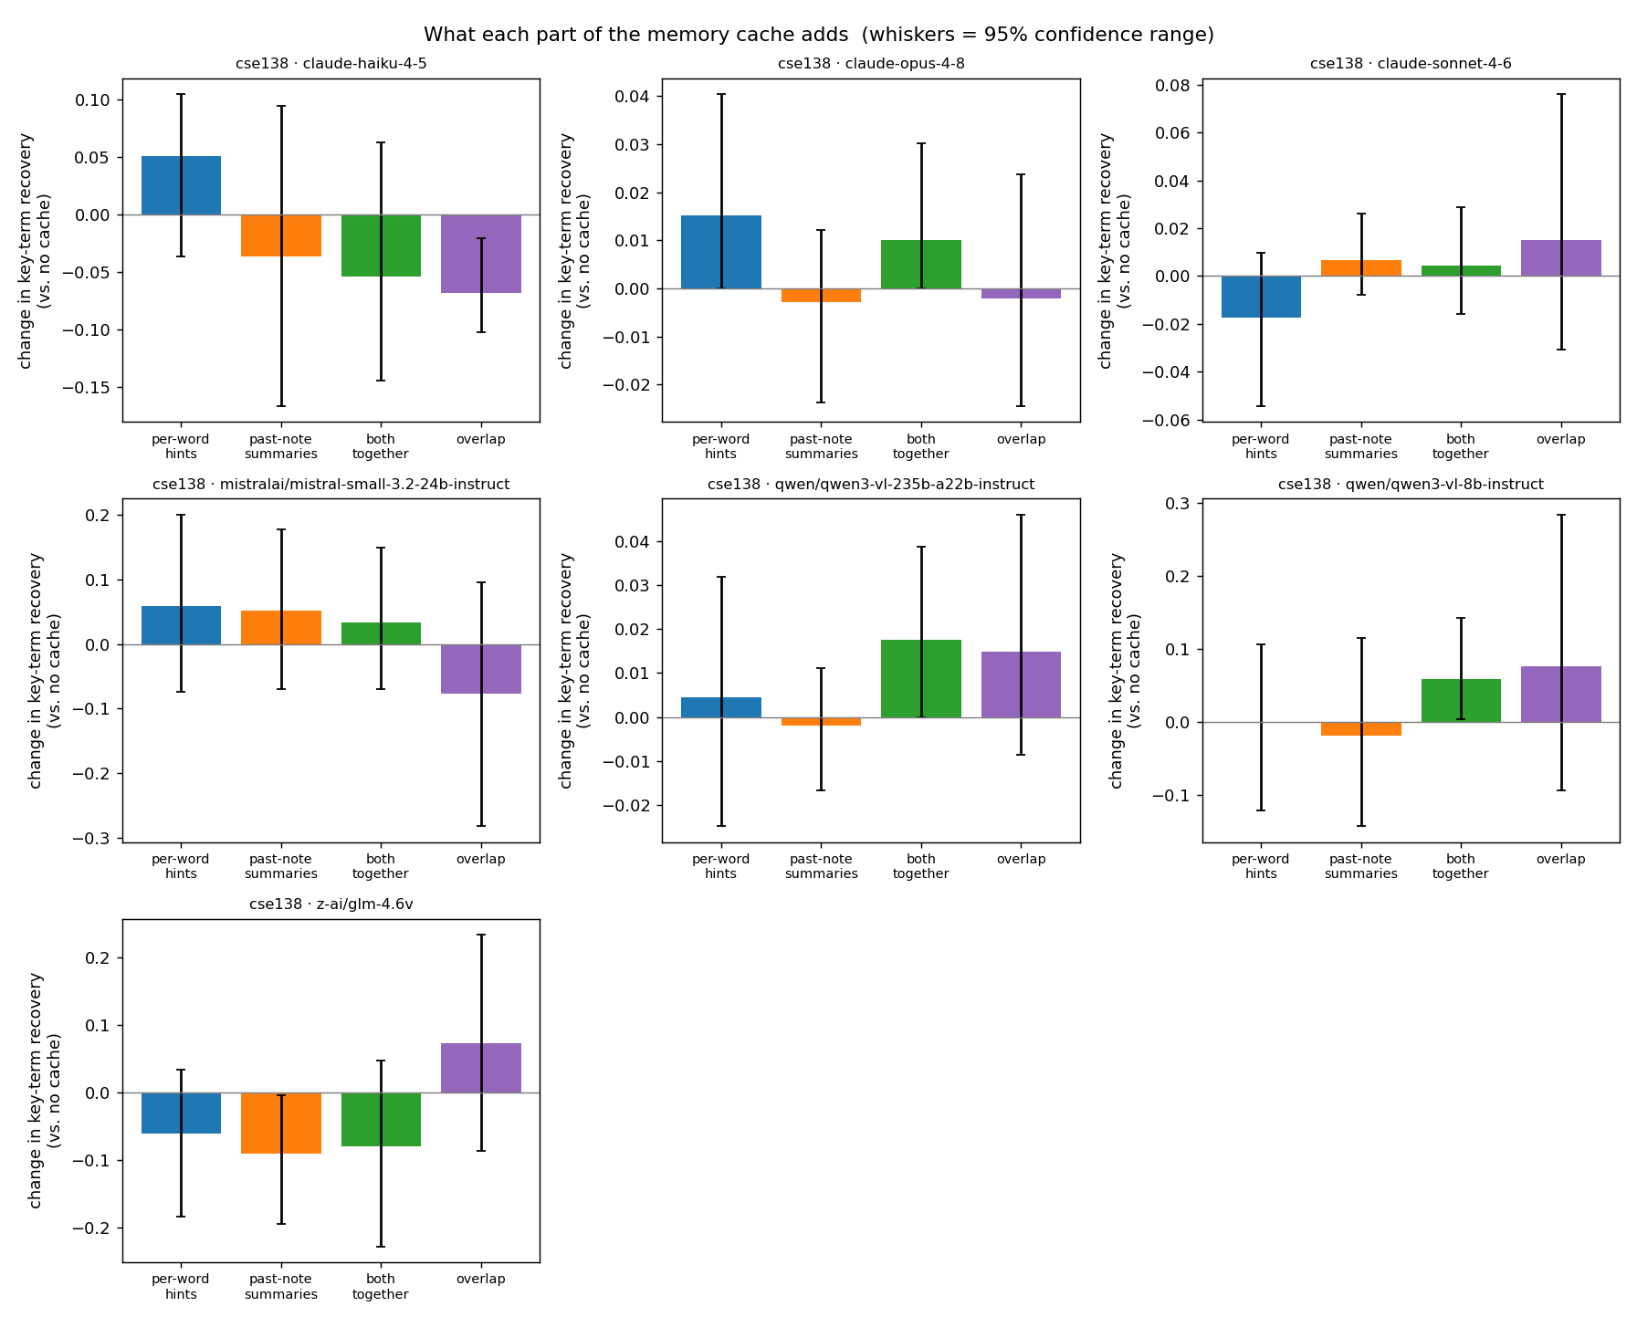
Evaluation (pt. 7)
Which parts of the cache actually contribute?
Whiskers: 95% confidence range
Overall, the uncommon word cache seems to have more of a signal to the LLM than the per notes summaries
Stronger models aren’t hurt by the extra context, but it also doesn’t help them as much

Slide 33
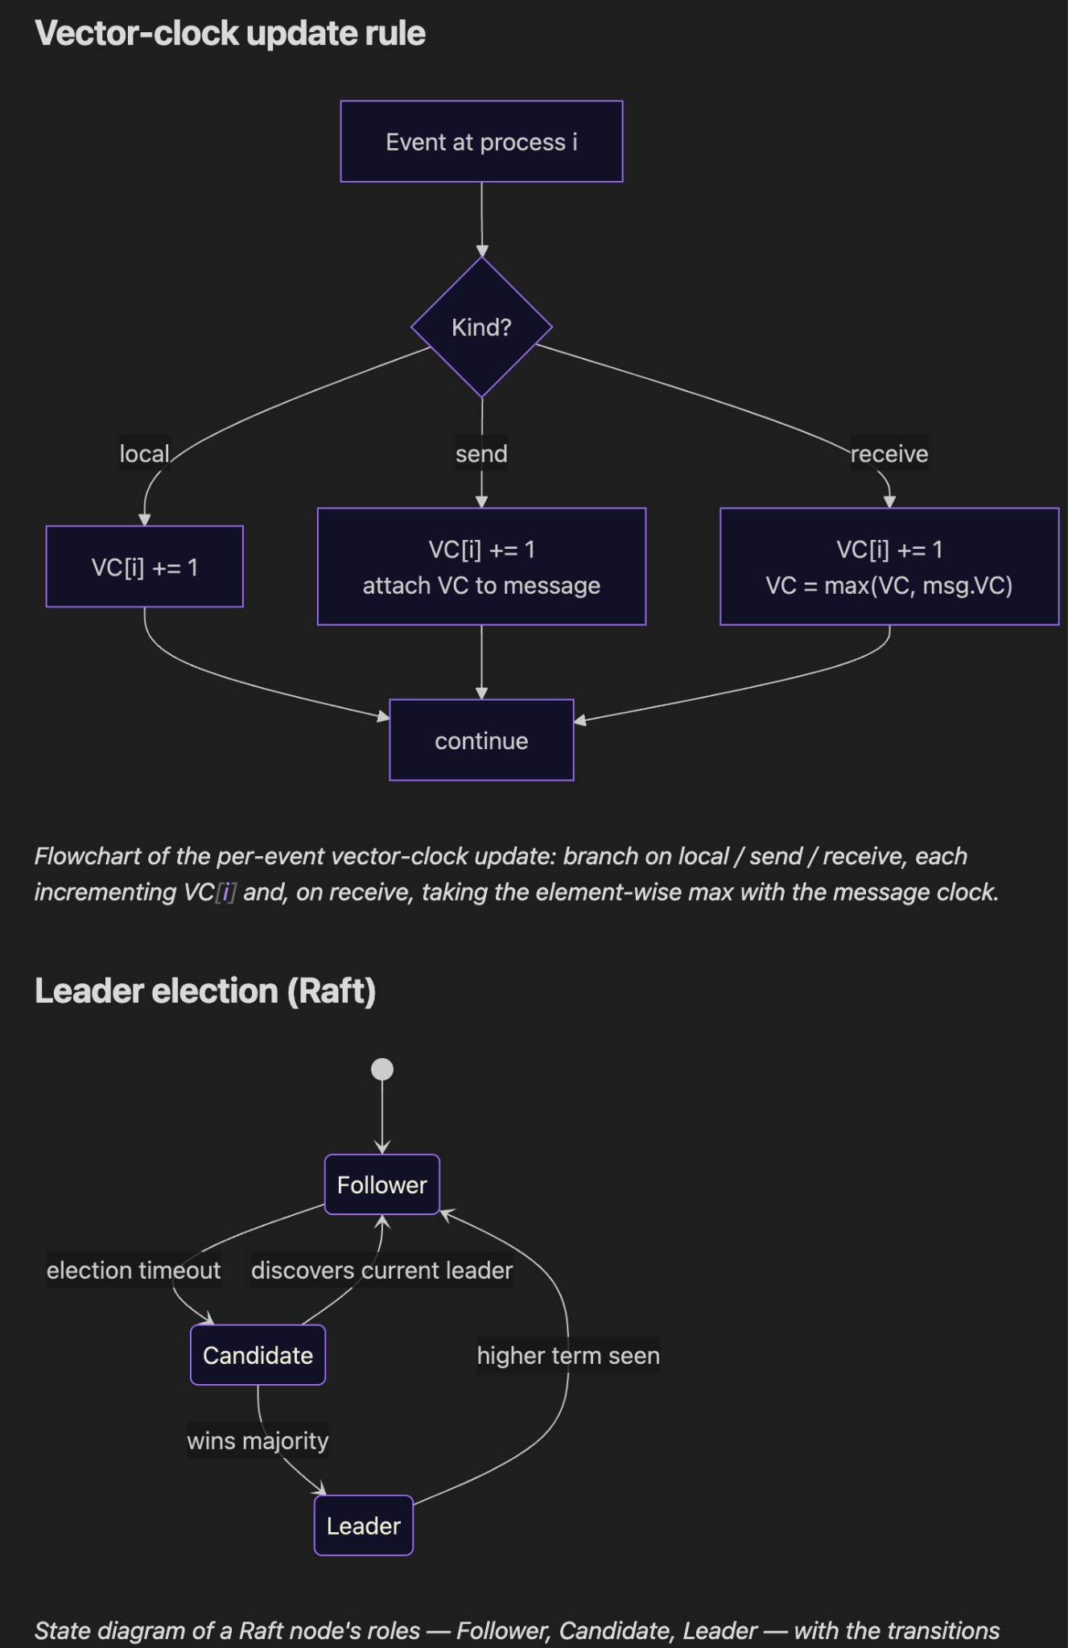
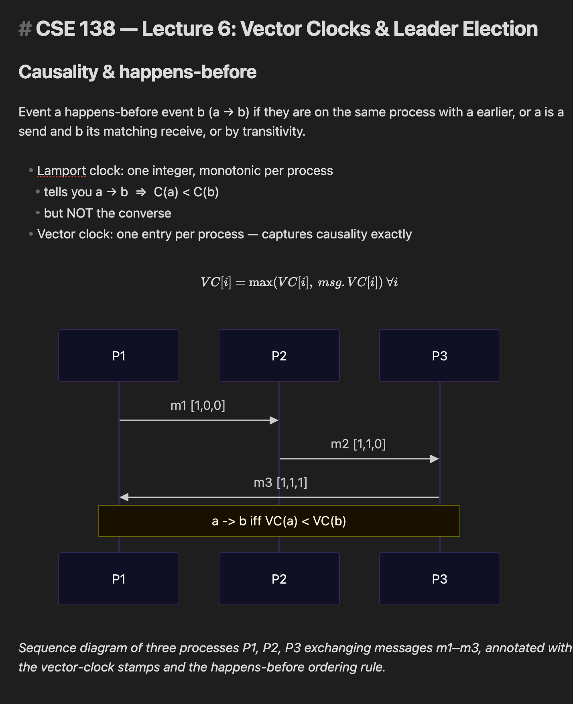
Example Output (.md)

Slide 34
Final Evaluation Analysis
Azure OCR was selected for its accuracy and reliable confidence scoring, compared to Tesseract.
VLM layer takes advantage of the highest intelligence models currently available
Qwen3 was chosen for its optimal cost-quality balance, compared to other models.
Cache makes the pipeline more efficient at recognizing uncommon terms over time.
Mermaid Diagrams allow diagrams to be digitally visualized, better than cropping the image.
The whole pipeline is relatively inexpensive.
Larger Models handle irrelevant context better than smaller models
  As VLM intelligence improves, the cache and OCR layers may become obsolete

Slide 35

Key Takeaways
OCR alone is insufficient for complex notes
  OCR extracts text well but struggles with diagrams, layout, and visual relationships.
LLMs improve document understanding when guided
  Combining OCR output with structured prompting enables reconstruction of diagrams and note structure.
Benchmark performance does not always reflect real-world performance
  Models advertised with high accuracy can still struggle on handwritten notes, diagrams, and noisy inputs.
Multimodal approaches provide the best results
  Combining OCR with vision-language reasoning preserves both textual and visual information well.
Future work: Explore OCR-free approaches inspired by Donut and Nougat, allowing a vision-language model to directly generate structured notes

Slide 36
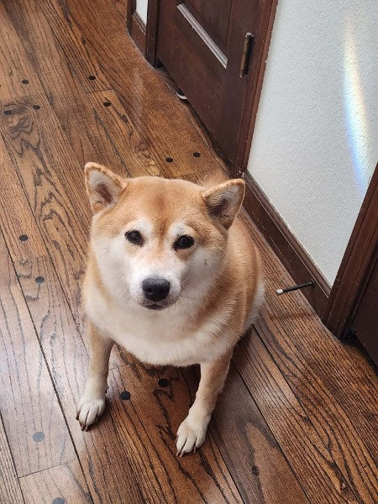
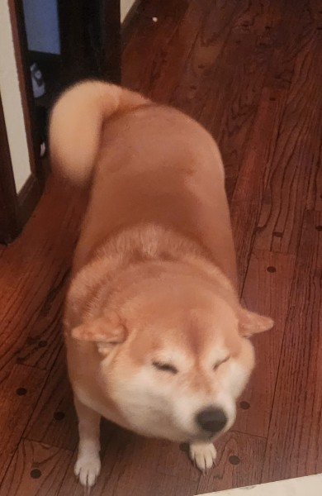

Who
is Miso???

Slide 37
Thank you!
Any Questions?
Special thanks to Professor Leilani Gilpin

